Slide 1
UVA Coupon
CS 6750 Database Systems - Project Presentation 2
Team Members: Mengyu Gong, Jingyi Luo, Kai Luo, Weihan Lyu, Mengyao Zhang
Feb. 21st, 2019

Slide 2
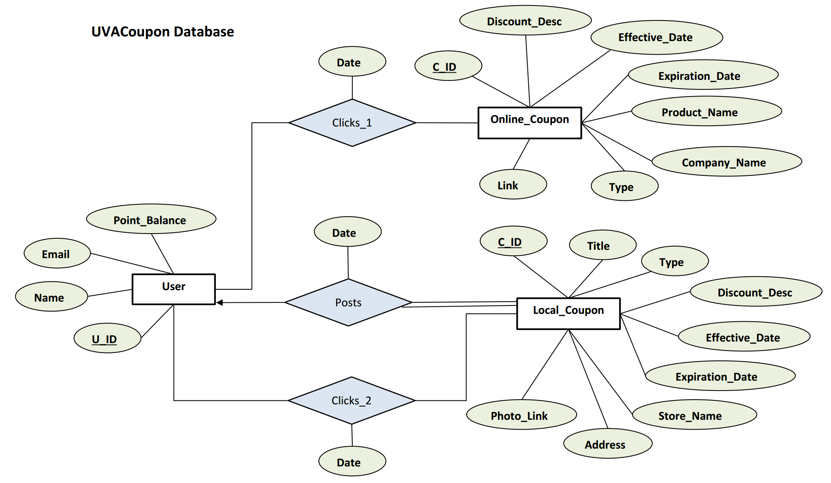
ER Diagram

Slide 3
User Table
U_ID | Name | Email | Point_Balance
100 | Ann | ann123@gmail.com | 10
101 | Ben | ben456@gmail.com | 50
Transactions
Add user account
Update email address
Update point balance for user
Retrieve user information on web application

Slide 4
Online_Coupon Table
C_ID | Discount_ Desc | Effective_Date | Expiration_Date | Product_ Name | Company_Name | Type | Link
810 | 25% | 02/20/2019 | 03/19/2019 | Shoes | Crocs | Fashion | https://www.crocs.com/
811 | 15% | 02/25/2019 | 03/02/2019 | Makeup | Sephora | Beauty | https://www.sephora.com/
Transactions
Add/Insert online_coupon information
Delete expired coupon information
Update information, e.g. discount, expiration date
Retrieve coupon information on web application

Slide 5
Local_Coupon Table
C_ID | Title | Type | Discount_Desc | Effective_Date | Expiration_Date | Store_ Name | Address | Photo_Link
100 | $3 off any whole pizza | Food | With Purchase of 3 Topping Pizza | 2019/2/15 | 2019/3/15 | LELO’S PIZZA | 1880 Abbey Rd | s3.example.jpg
Transactions
Add/Insert local_coupon information
Delete expired coupon information
Update information, e.g. discount, expiration date
Retrieve coupon information on web application

Slide 6
Clicks_1 , Clicks_2 & Post tables
Click_1
Click_2
U_ID | C_ID(online) | Date
100 | 801 | 20190220
U_ID | C_ID(local) | Date
100 | 610 | 20190219
Post
U_ID | C_ID(local) | Date
100 | 610 | 20190218
Transactions
Retrieve users’ browse record
Count total views of coupons
Provide statistical data for updating the point_balance of users
Search specific local coupons posted by users

Slide 7
Select Query Example (Search Specific Coupons)
Find DSW coupons of all types of shoes, except boots, posted by user Jane.
SELECT *
FROM User NATURAL JOIN Posts NATURAL JOIN Local_Coupon
WHERE Name = “Jane” AND Store_Name = “DSW” AND Type <> “boot”
Notes:
Assume we have a user who would like to find some coupons which are posted by user Jane of DSW, and the user would like to see the coupons of all types of shoes except boots. So we would have the following query to meet the user’s requirement:
(SELECT C_ID
FROM User NATURAL JOIN Posts NATURAL JOIN Local_Coupon
WHERE Name = “Jane” AND Store_Name = “DSW” AND Type = “boot”)

Slide 8
Thank you!

